Slide 1



Pens Down Please!
Implementing and Carrying Out
E-Enabled Assessments

Slide 2
An unexpected journey
– how Aalen did 20k online exams
OEB 2021
Dr. Martin Franzen

Slide 3

hybrid strategy now
profile
engineering, business, IT
statistics
6.5k students
0.5k professors
public university
– winter 19: on site
summer 20 – summer 21: online
winter 21 – : hybrid strategy

Slide 4
3-component platform succeeds
Canvas (since 2019)
BigBlueButton (since 2019), Zoom (since 2020)
DigiExam (since 2020)
ed tec: technology/ support/ communications
5 employees
25 student assistants
studycheck.de
Digital Readiness: 8th place among German universities

Slide 5
online exam journey
options
winter 21: on site
summer 20: remote (~33%)
exams by DigiExam
summer 20: 6.6k
winter 20: 6.7k
summer 21: 6.8k
customizing
EU company: developers & sales
local educational laws (LHG) & state’s data protection officer: compliant

Slide 6
the examination process
last questions: via Zoom
start: via Canvas
execution: via DigiExam
  automized identification
  locked mode
  live proctoring
hotline
  solving & documenting technical problems, i.e. internet
end/ hand in/ grading

Slide 7
the battle of the two armies: freedom from deception vs GDPR
legal basis
state’s university laws (10 states so far)
internally
task force with all stakeholders including students
externally
dialogue with our ministry and our state’s data protection officer Dr. Stefan Brink
(30-page document upon request canvas@hs-aalen.de)
Dr. Stefan Brink
"DigiExam indeed is the tool that can be configured more easily in a privacy suitable way."
at Stiftung Datenschutz „Datenschutz am Mittag“, June 8th, 2021

Slide 8

Digital exams from the supervised exam rooms to your own computer
OEB2021
Liisa Kallio
University of Jyväskylä, Finland

Slide 9
In this presentation
Background and presenting the EXAM concept
The byod exam project
  Concept
  Pilot experiences
  Next steps

Slide 10
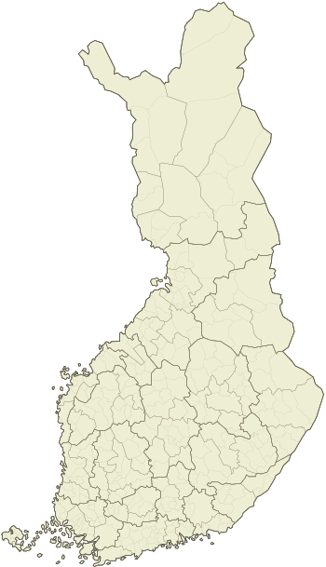


























EXAM-consortium in Finland
Universities and universities of applied sciences
27
EXAM attainments
125 500 (2020)
170 000 (2019)
EXAM visit organizations
19

Slide 11
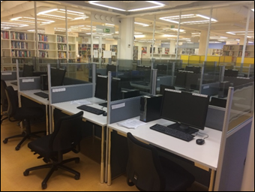
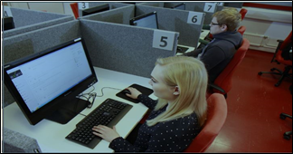
EXAM concept for supervised digital exams
The EXAM software.
Customized workstations and network environment.
EXAM rooms with camera surveillance (recorded) and the process of remote supervision.
Flexibility of studies for the students: can freely choose their exam time and date (and the location).
First implementations of the service in 2015.
Licensed under EUPL.

Slide 12

Main functionalities
Teacher
Student
Administrator
Shared Resources
Creating an exam
Registration and time‐booking
User management
EXAM Visit
Question types and attachments
Choosing exam subjects
Exam rooms management
Joint exams
Question library
Taking an exam
Statistics and reports
In development
Assessment
Reading the assessment and feedback
Other setting controls
BYOD exams
Analytics
Interfaces
E-mail notifications

Slide 13
Covid19 lockdown in March 2020
Urgent need to reorganize teaching and exams (campuses closed).
Proctoring became a big issue.
Priorities for the EXAM development were changed.

Slide 14
Open BYOD exam
Restricted BYOD (with Safe Exam Browser=SEB)
The teacher creates the exam normally and adds the exam event(s).
The student logs in to EXAM with own device and the exam opens when the exam event starts.
The student can use all resources of the device and has access to the internet.
The student registers for the exam event.
The teacher creates the exam normally and adds the exam event(s).
The exam is started with a SEB starting file which the student receives as an attachment of the confirmation email.
SEB allows access only to EXAM and blocks all other resources as well as access to the internet.
After submitting the exam SEB releases the computer for normal use.
The student registers for the exam event and installs the Safe Exam Browser to the computer before the exam event.

Slide 15
Strengths and challenges of the byod EXAM
Strengths
Being able to use the familiar functionalities (exams, question bank, assessment tools).
Integrations to the student information systems.
Centralized support.
  All exams in one service.
    The teachers find EXAM easier to use than some LMSs.
Exceptional cases and arrangements.
Challenges
No proctoring.
Load and capacity.
Attachments and use of other software in the restricted byod (SEB).
Finding suitable use cases for pilots.
  General exam events, final exams.
  Home exams.
  Exams with special needs.

Slide 16
What happens when we're back to normal?
How to replace the paper exams?
What is the role of the BYOD exams in EXAM?
Are we going back or is this the normal?
The role of proctoring, data privacy, GDPR.

Slide 17
THANK YOU!
Liisa Kallio liisa.kallio@jyu.fi
More information about EXAM: https://e-exam.fi/in-english/
twitter: #examfi

